Slide 1
Introduction to Azure Machine Learning and Data Mining algorithms
Oleksandr Krakovetskyi
CEO, DevRain Solutions
PhD, Microsoft Regional Director
@msugvnua, alex.krakovetskiy@devrain.com

Slide 2
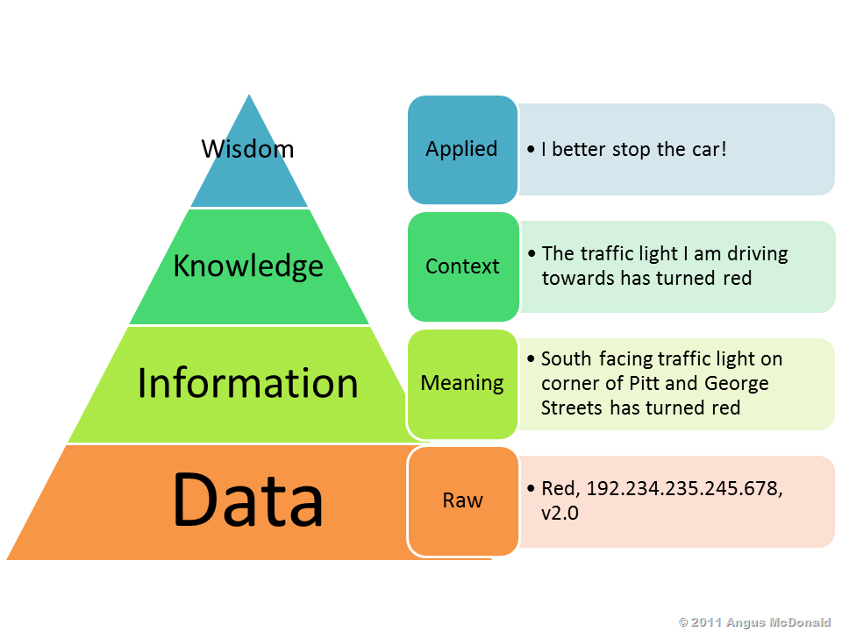
Levels of data

Slide 3
Data Mining
The computational process of discovering patterns in large data sets involving methods at the intersection of artificial intelligence, machine learning, statistics, and database systems.

Slide 4
Data Mining process
Selection
Pre-processing
Transformation
Data Mining
Interpretation/Evaluation

Slide 5
Working with data
Different sources: databases, web, local files, semantic web, storages etc.
Different formats: text, HTML, PDF, Word, JSON/XML.
Parsing HTML-based sources.
Data cleaning, filtering, sorting, saving.

Slide 6
Data Mining tasks
Anomaly detection
Association rule learning (Dependency modelling)
Clustering
Classification
Regression
Summarization
NLP

Slide 7
Machine Learning
Machine learning is the science of getting computers to act without being explicitly programmed.

Slide 8
Microsoft and Machine Learning
Microsoft & Machine Learning
1999
2004
2005
2008
2010
2012
2014
Spam filtration
Using Data Mining in search engines
SQL Server Data Mining
Bing Maps started to use ML for traffic estimate
Gestures understanding in Microsoft Kinect
Voice recognition
Azure Machine Learning
Notes:
Back in the 90s when the post office was wrestling with this issue, we were also working on Machine Learning, starting in 1991 when Microsoft Research was formed.
As early as 1999 they were using it to help create email filters by predicting which emails were junk, and which were relevant.
And as John Platt mentions—it’s a key technology that Microsoft uses to develop its own software. In 2004. Machine learning was part of Microsoft’s search engine
It is also used in Bing Maps as part of the traffic prediction service.
And many people know about how it was a key technology to make Kinect a reality, letting computers track people’s gestures and sort through what’s relevant and what’s not. Like filtering out a dog in the background to see a player’s movements.
And today, this technology that has been developed over decades is becoming available commercially as part of Azure
It’s this depth of experience with machine learning, testing and refining over years, using it to develop pretty much all Microsoft products, that makes Microsoft’s solution so robust.

Slide 9
2015 Skype translator
http://www.skype.com/en/translator-preview/
https://www.youtube.com/watch?v=bx3TuEeNpnc

Slide 10
Machine Learning Algorithms
Algorithm | Binary Classification in Azure ML | Multiclass Classification in AzureML | Regression in Azure ML
Logistic Regression | Two-class logistic regression | Multiclass Logistic Regression
Linear Regression |  |  | Linear Regression
Support Vector Machine | Two-class support vector machine | One-vs-all + support vector machine
Decision Tree | Two-class boosted decision tree | One-vs-all + boosted decision tree | Boosted decision tree regression
Neural Network | Two-class neural network | Multiclass neural network | Neural network regression
Random Forest | Two-class decision forest | Multiclass decision forest | Decision forest regression

Slide 11

Azure Machine Learning
Web Apps
Mobile Apps
PowerBI/Dashboards
ML API service
Developer
Azure Portal
ML Studio
Azure Portal & ML API service
HDInsight
Azure Storage
Azure Ops Team
Data analyst
Desktop Data
Notes:
Let’s walk through how a machine learning solution comes to life, from setting up the environment to extracting insight.
First, The Azure ops team, maybe already accustomed to managing storage accounts or provisioning Azure virtual machines, can get a machine learning environment set up right from the Azure Portal. They start by creating an ML Studio workspace and dedicated storage account to get their data scientists up and running.
<click>
When the Azure Ops team sets up the data scientist, she’ll get an email to her Windows Live account that gives her one-click to get started.
The data scientist will then spend her time in ML Studio. From there, she can execute every step in the data science workflow.
She can access and prepare data
Create, test and train models, as well as import her company’s proprietary models securely into her private workspace
Work with R and over 300 of the most popular R packages along with Microsoft’s business class algorithms
Collaborate with colleagues within the office or across the globe as easy as clicking “share my workspace”
Deploy models within minutes rather than weeks or months
<click>
And the data scientist has her choice of what data she wants to pull into her models. She can access data already in Azure, query across Big Data in HDInsight, or pull datasets in right from her desktop.
<click>
Once the data scientist is ready to publish, she signals the Azure Ops team. This is when tested models become available to developers via the API service.
<click>
The Azure ops team then uses the ML API service to deploy the model in minutes, making it accessible to developers.
<click>
The developer can surface the model in apps, by simply grabbing auto-generated code and dropping it in. Then business users can access results, from anywhere, on any device. And any model updates simply refresh the model in production with no new development work needed.

Slide 12
Demo
Working with Azure ML Studio
Creating basic NER
Working with gallery

Slide 13
References
http://blogs.msdn.com/b/microsoft_press/archive/2015/04/15/free-ebook-microsoft-azure-essentials-azure-machine-learning.aspx
http://habrahabr.ru/company/microsoft/blog/254637/
http://azure.microsoft.com/uk-ua/services/machine-learning/
https://channel9.msdn.com/Tags/machine+learning

Slide 14
Q&A
Oleksandr Krakovetskyi
CEO, DevRain Solutions
PhD, Microsoft Regional Director
@msugvnua
alex.krakovetskiy@devrain.com

